Slide 1

Presented by: Ankit Mhadye, Ashik Ahamed, Bhakti Shetty, Bhaskar Reddy, Owen Trombly
Mentor: Prof. Jeanna Matthews
Proposed by: Ali Boolani
Date: 04/11/2025

Slide 2
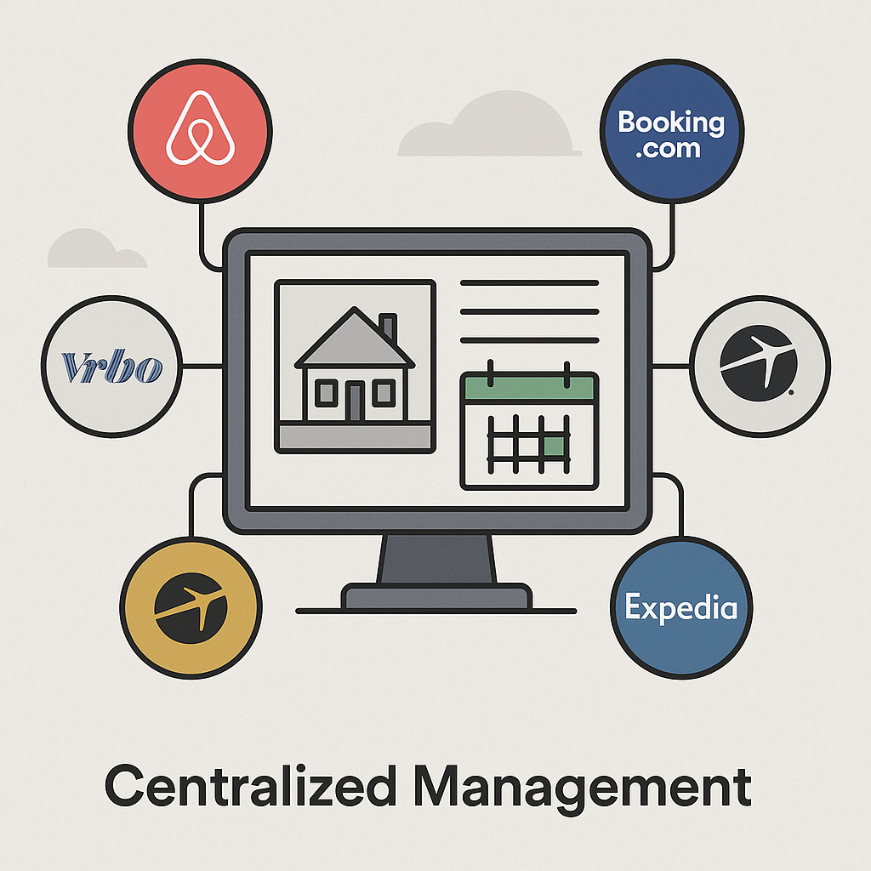
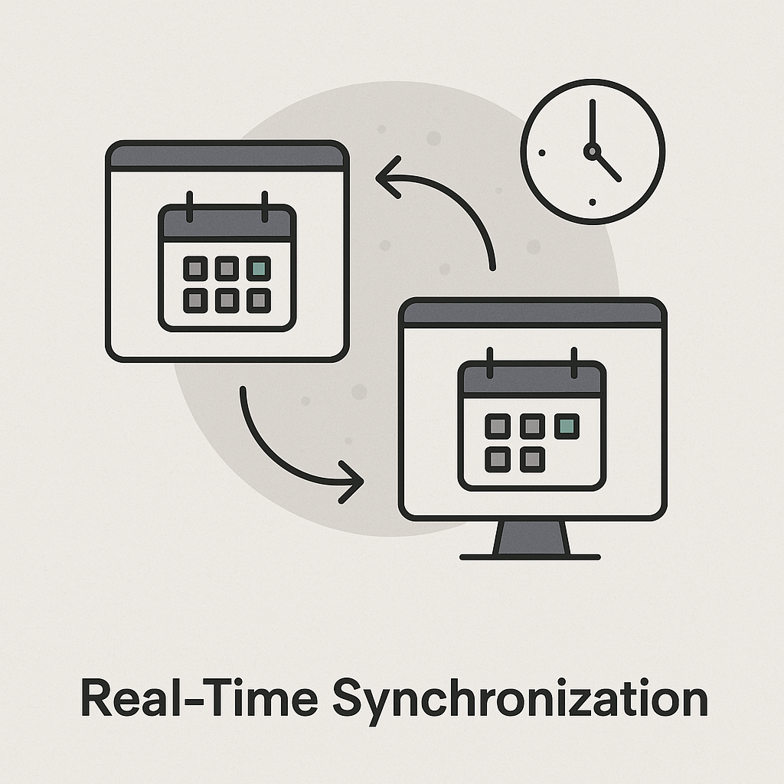


Necessity of Booking Site Aggregator

Slide 3



Existing Applications

Slide 4
What is new in our application?
Multi-Platform Booking Integration
Smart Lock Integration
Automated Messaging System
Housekeeping & Staff Scheduling
Inventory & Supplies Management
Built-in Point of Sale (POS)
Dedicated Booking Website
Guest Add-On System
Raw Data Access
Dynamic Pricing Integration
Activity & Equipment Rentals

Slide 5



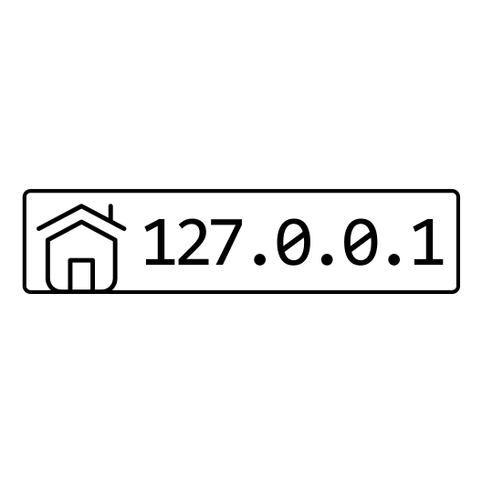

What we build with?
FRONTEND
BACKEND
DATABASE
CLOUD HOSTING
PAYMENT GATEWAY

Slide 6
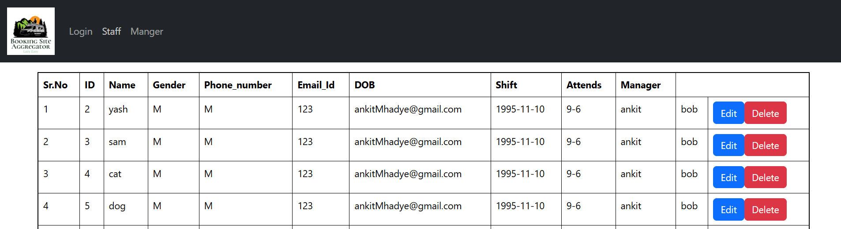
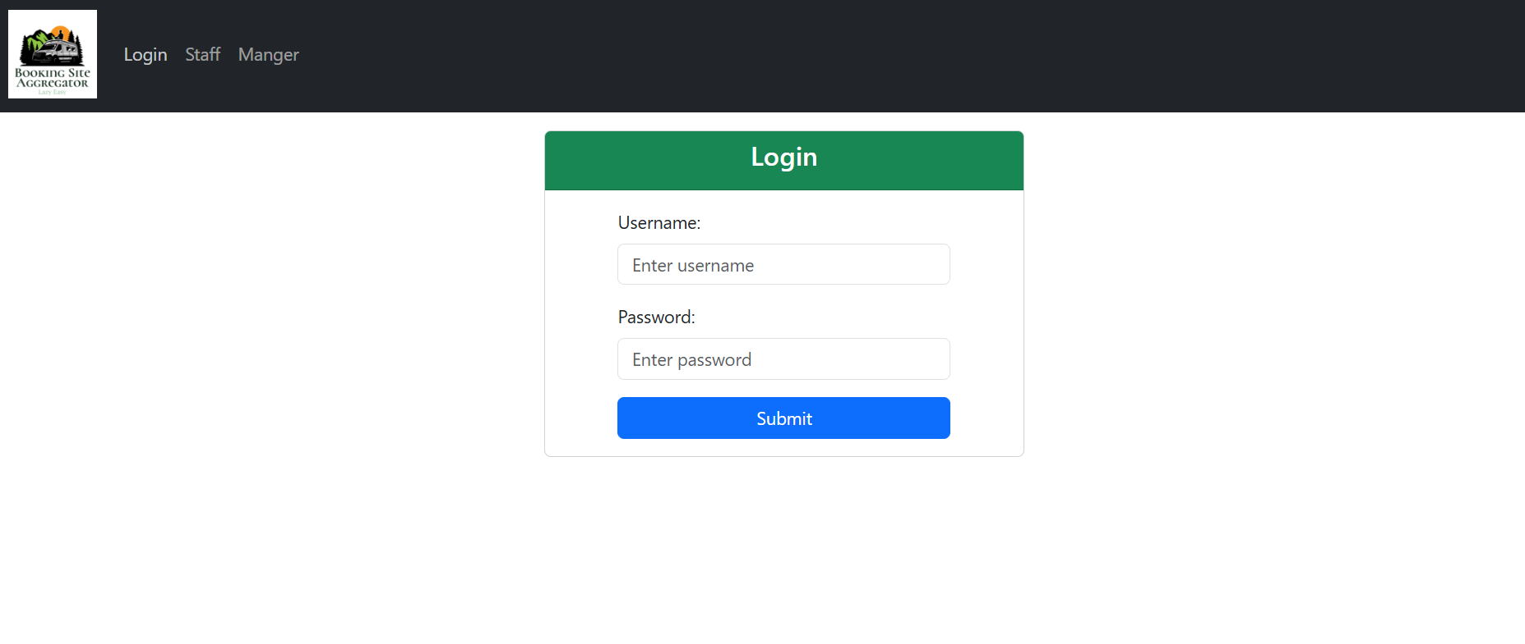
Application Snippets

Slide 7

Application Demo

Slide 8
Conclusion
Our Booking Site Aggregator simplifies property management by bringing everything under one roof — from multi-platform booking sync to smart lock control, automated messaging, and dynamic pricing.
It not only streamlines operations but also empowers hosts to save time, reduce errors, and increase revenue, while delivering a better experience to guests.
With a scalable architecture and future-ready integrations, our platform lays the foundation for full independence from third-party booking platforms.

Slide 9
Thank you!

